Slide 1
Working with strings and texts
Principles of programming

Slide 2
Introduction
In this lecture we will explore strings.
We are going to explain how they are implemented in C# and in what way we can process text content.
Additionally, we will go through different methods for manipulating a text:
how to compare strings
how to search for substrings
how to extract substrings upon previously settled parameters
how to split a string by separator chars.

Slide 3
Introduction
How to correctly build strings with the StringBuilder class.
Most commonly used regular expressions.
Efficient construction of strings.
Elegant and stricter formatting of the text content.

Slide 4
Strings
In practice we often come to the text processing: reading text files, searching for keywords and replacing them in a paragraph, validating user input data, etc…
In such cases we can save the text content, which we will need in strings, and process them using the C# language.

Slide 5
What is a string?
A string is a sequence of characters stored in a certain address in memory.
Remember the type char?
In the variable of type char we can record only one character.
Where it is necessary to process more than one character then strings come to our aid.

Slide 6
What is a string?
In. NET Framework each character has a serial number from the Unicode table. The Unicode standard is established in the late 80s and early 90s in order to store different types of text data.
Its predecessor ASCII is able to record only 128 or 256 characters (respective ASCII standard with 7-bit or 8-bit table). Unfortunately, this often does not meet user needs – as we can fit in 128 characters only digits, uppercase and lowercase Latin letters and some specific individual characters. When you have to work with text in Cyrillic or other specific language (e.g. Chinese or Arabian), 128 or 256 characters are extremely insufficient.
Here is why .NET uses 16-bit code table for the characters. The code table store 2^16 =65536 characters. Some characters are encoded in a specific way, so it is possible to use two characters of the Unicode table to create a new character – the resulting signs exceed 100,000.

Slide 7
The System.String Class
The class System.String enables us to handle strings in C#.
For declaring the strings we will continue using the keyword string, which is an alias in C# of the System.String class from .NET Framework.
The work with string facilitates us in manipulating the text content: construction of texts, text search and many other operations.

Slide 8

Declaring strings
The internal representation of the class is quite simple – an array of characters.
We can avoid the usage of the class by declaring a variable of type char[] and fill in the array’s elements character by character. However, there are some disadvantages too:
Filling in the array happens character by character, not at once.
We should know the length of the text in order to be aware whether it will fit into the already allocated space for the array.
The text processing is manual

Slide 9
Strings are Immutable
The type string is more special from other data types. It is a class and as such it complies with the principles of object-oriented programming. Its values are stored in the dynamic memory (managed heap), and the variables of type string keeps a reference to an object in the heap.
The string class has an important feature – the character sequences stored in a variable of the class are never changing (immutable). After being assigned once, the content of the variable does not change directly – if we try to change the value, it will be saved to a new location in the dynamic memory and the variable will point to it.

Slide 10
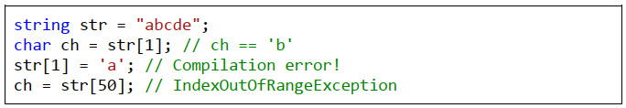
Strings and Char Arrays
Strings are very similar to the char arrays (char[]), but unlike them, they cannot be modified.
Like the arrays, they have properties such as Length, which returns the length of the string and allows access by index. Indexing, as it is used in arrays, takes indices from 0 to Length-1.
Access to the character of a certain position in a string is done with the operator [] (indexer), but it is allowed only to read characters (and not to write to them):

Slide 11

Strings Escaping
If we want to use quotes into the string content, we must put a slash before them to identify that we consider the quotes character itself and not using the quotation marks for ending the string:
The quotes in the example are part of the text. They are added in the variable by placing them after the escaping character backslash (\). In this way the compiler recognizes that the quotes are not used to start or end a string, but are a part of the data.
Displaying special characters in the source code is called escaping.

Slide 12

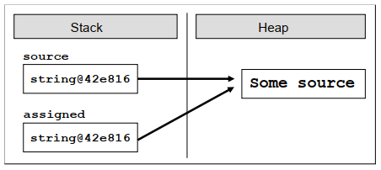
Assigning Value of Another String
First, we declare and initialize the variable source. Then the variable assigned takes the value of source. Since the string class is a reference type, the text "Some source" is stored in the dynamic memory (heap) on an address defined by the first variable.

Slide 13
Assigning Value of Another String
In the second line we redirect the variable assigned to the same place, which the other variable points to.
In this way the two objects receive the same address in dynamic memory and hence the same value.
The change of either variable will affect only itself because of the immutability of the type string, as when a change occurs, a copy of the changed string will be created.
This is not true for the rest of the reference types (the normal, mutable types) because with them the changes are made directly in the address in memory and all references point to this changed address

Slide 14
Reading and Printing to the Console

Slide 15
Comparison for Equality
If the requirements are to compare the two strings in order to determine whether their values are equal or not, the most convenient method is the Equals(…), which works equivalently to the operator ==.
It returns a Boolean result with either true value, if the strings have the same values, or false value, if they are different.
The method Equals(…) checks letter by letter for equality of string values, as it makes distinction between small and capital letters, i.e. comparing the "c#" and "C#" with the Equals(…) method will return the value false. Consider the following example:

Slide 16
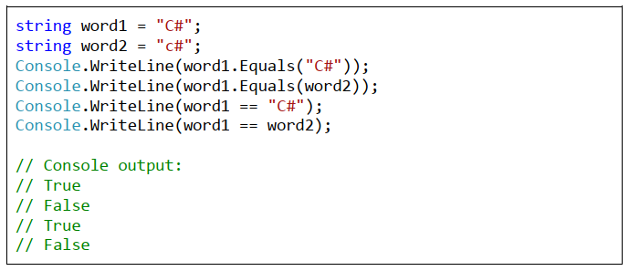

Comparison for Equality

Slide 17
Comparing Strings in Alphabetical Order
It has become clear how we compare strings for equality, but how we are going to establish the lexicographical order of several strings? If we try to use the operators < and > which work great for comparing numbers, we find out that they cannot be used for strings.
If you want to compare two words and get information which one of them is before the other according to their alphabetical order of letters, here comes the method CompareTo(…). It allows us to compare the values of two strings in order to determine their lexicographical order.
In order two strings to have the same values, they must have the same length (number of characters) and the all their characters should match accordingly. For example, the strings "give" and "given" are different because they differ in their lengths, and "near" and "fear" differ in their first character.

Slide 18
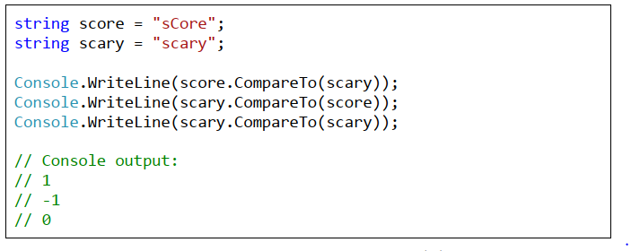
Comparing Strings in Alphabetical Order
The method CompareTo(…) from the String class returns a negative value, 0 or positive value depending on the lexical order of the two compared strings.
A negative value means that the first string is lexicographically before the second, zero means that the two strings are equal and positive value means that the second string is lexicographically before the first.

Slide 19
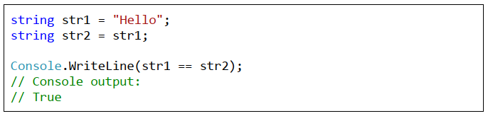
The == and != Operators
In the C# language the operators == and =! work for strings through an internal calling of Equals(…). We will go through some examples for using those two operators with variables from the string type:

Slide 20

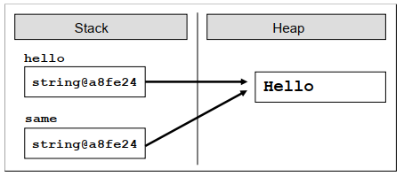
Memory Optimization for Strings (Interning)
The string interning in .NET is possible because strings are immutable by design and it is not likely that the memory block referenced by several string variables will simultaneously be changed by someone.

Slide 21


Strings Concatenation
Gluing two strings and obtaining a new one as a result is called concatenation. It could be done in several ways: through the method Concat(…) or with the operators + and +=.
Example of using the method Concat(…):

Slide 22


Strings Concatenation
Please note that string concatenation does not change the existing strings but returns a new string as a result. If we try to concatenate two strings without storing them in a variable, the changes would not be saved.
Here is a typical mistake:

Slide 23
Searching for a String within Another String
When we have a string with a specified content, it is often necessary to process only a part of its value. The .NET platform provides us with two methods to search a string within another string: IndexOf(…) and LastIndexOf(…).
They search into the string and check whether the passed as a parameter substring occurs in its content.
The result of those methods is an integer.
If the result is not a negative value, then this is the position where the first character of the substring is found. If the method returns value of -1, it means that the substring was not found. Remember that in C# indexing into strings start from 0.

Slide 24
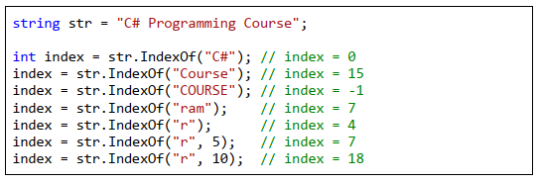
Searching for a String within Another String

Slide 25

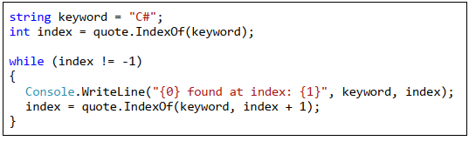
Finding All Occurrences of a Substring – Example

Slide 26

Extracting a Portion of a String
The solution of this problem is the method Substring(…). By using it, we can extract a part of the string (substring) by a given starting position in the text and its length. If the length is omitted, a portion from the text will be extracted, starting from the initial position to the string’s end.
Calling the method Substring(startIndex, length), extracts a substring from a string, which is located between startIndex and (startIndex + length – 1) inclusively. The character at the position startIndex + length is not taken into consideration! For example, if we point Substring(8, 3), the characters between index 8 and 10 inclusively will be extracted.

Slide 27


Splitting the String by a Separator
One of the most flexible methods for working with strings is Split(…). It allows us to split a string by a separator or an array of possible separators.
For example, we can process a variable, which has the following content:

Slide 29
Replacing a Substring
The text processing in .NET Framework provides ready methods for replacing a substring with another. For example, if we have made one and the same technical mistake when typing the email address of a user in an official document, we can replace it by using the method Replace(…)
The method Replace(…) replaces all occurrences of a given substring with another substring, not just the first.

Slide 30
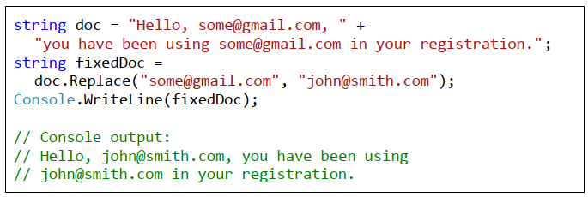
Replacing a Substring

Slide 31
Regular Expressions
The regular expressions are a powerful tool for text processing and allow searching matches by a pattern. An example for a pattern is [A-Z0-9]+, which means not an empty series of capital Latin letters and numbers.
Regular expressions make text processing easier and more accurate:
extracting some resources from texts,
searching for phone numbers,
finding email addresses in a text,
splitting all the words in a sentence,
data validation, etc.

Slide 32
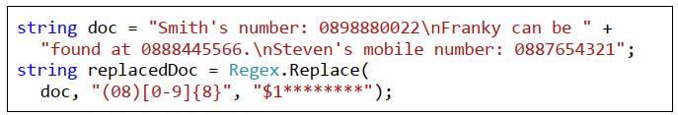
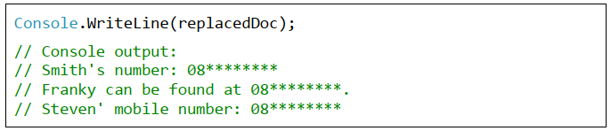
Regular Expressions – Example
If we have an official document that is used only in the office and it contains a lot of personal data, then we should censor it before sending it to the client.
For example, we can censor all mobile numbers and replace them with asterisks. By using regular expressions, this could be done as follows:

Slide 33
Regex.Replace(…)
Class System.Text.RegularExpressions.Regex, which is intended for use with regular expressions in .NET Framework.
The variable, which imitates the document text, is doc.
Phones are saved in the format: "08 + 8 digits",
The method Regex.Replace(…) finds all matches by a given format and replaces them with: "08********".
The regular expression that finds all of the numbers is the following: "(08)[0-9]{8}". It finds all substrings in the text, constructed by the constant "08“ and followed exactly by 8 characters ranging from 0 to 9.

Slide 34
Regex.Replace(…)
The literal "08" is surrounded by parentheses. They serve for forming a separate group in the regular expression. The groups can be used for handling only a certain part of the expression instead of the entire expression. In our example, the group is used in the substitution.
Through it, the founded matches are replaced by the pattern "$1********", i.e. the text which was found in the first group of the regular expression ($1) + 8 consecutive asterisks for censorship.
As the defined group is always a constant (08), so the text replaced will always be: 08 ********.

Slide 35
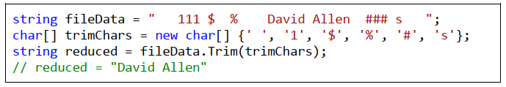
Removing Unnecessary Characters at the Beginning and at the End of a String

Slide 36
Regex
Anyone who wants to learn more, can search for articles, books and tutorials in order to learn how to construct regular expressions, how to look for matches, how validation is made, how to make substitutions by patterns, etc. In particular, we recommend you to visit the websites http://www.regular-expressions.info and http://regexlib.com
More information about the classes in .NET Framework for working with regular expressions can be found at: http://msdn.microsoft.com/enus/library/system.text.regularexpressions.regex%28VS.100%29.aspx
Regex cheat sheet https://cheatography.com/davechild/cheat-sheets/regular-expressions/

Slide 37
Constructing Strings: the StringBuilder Class
As explained above, strings in C# are immutable.
This means that any adjustments applied to an existing string do not change it but return a new string.
For example, using methods like Replace(…), ToUpper(…), Trim(…) do not change the string, which they are called for. They allocate a new area in the memory where the new content is saved.
This behavior has many advantages but in some cases can cause performance problems.

Slide 38

Strings Concatenation
Serious performance problems may be encountered when trying to concatenate strings in a loop.
The problem is directly related to the strings handling and dynamic memory, which is used to store them.
To understand why we have poor performance when concatenating strings in a loop, we must first consider what happens when using operator "+" for strings.

Slide 39
Strings Concatenation
What will happen with the memory? Creating the variable result will allocate a new area in dynamic memory, which will record the outcome of the str1 + str2, which is "SuperStar". Then the variable itself will keep the address of the allocated area. As a result we will have three areas in memory and three references to them. This is convenient, but allocating a new area, recording a value, creating a new variable and referencing it in the memory is time consuming process that would be a problem when repeated many times, typically inside a loop.
Unlike other programming languages, in C# is not necessary to manually dispose the objects stored in memory. There is a special mechanism called a garbage collector (memory cleaning system), which takes care of clearing the unused memory and resources. The garbage collector is responsible for disposing of objects in dynamic memory when they are no longer used. Creation of many objects containing multiple references in dynamic memory is bad, because it fills memory and then the garbage collector is automatically enforced to start execution. It takes quite some time and slows the overall performance of the process.
Furthermore, transferring characters from one place to another in memory (when string concatenation is executed) is slow, especially if the strings are long.

Slide 40
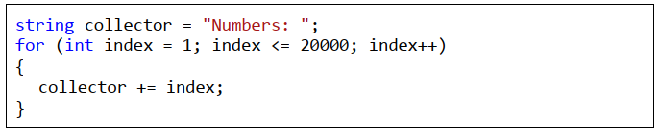
Concatenating Strings in a Loop
Execution of the above code will loop 20,000 times and after each iteration will add the current index to the collector variable. collector’s value after implementation would be: "Numbers: 12345678910111213141516…"
Example …

Slide 41
Building and Changing Strings with StringBuilder
StringBuilder is a class that serves to build and change strings.
It overcomes the performance problems that arise when concatenating strings of type string.
The class is built in the form of an array of characters and what we need to know about it is that the information in it can be freely changed.
Changes that are required in the variables of type StringBuilder, are carried out in the same area of memory (buffer), which saves time and resources.
Changing the content does not create a new object but simply changes the current.

Slide 42
How Does the StringBuilder Class Work?
StringBuilder keeps a buffer with a certain capacity (16 characters by default). The buffer is implemented as an array of characters that is provided to the developer by a user-friendly interface – methods that quickly and easily add and edit elements of the string. At any moment part of the characters in the buffer are used and the rest stay in reserve. This allows the addition to work very quickly. Other operations also operate faster than the class string, because the changes do not create a new object.
Once the internal buffer of the StringBuilder is full, it automatically is doubled (the internal buffer is resized to increase its capacity while its content is kept unchanged). Resizing is a slow operation but is happens rarely so the total performance is good.

Slide 43
Processing Strings in the Memory
Several things happen at each step:
1. An area of memory is allocated for recording the next number concatenation result. This memory is used only temporarily while concatenating, and is called a buffer.
2. The old string is moved into the new buffer. If the string is long (say 500 KB, 5 MB or 50 MB), it can be quite slow!
3. Next number is concatenated to the buffer.
4. The buffer is converted to a string.
5. The old string and the temporary buffer become unused. Later they are destroyed by the garbage collector. This may also be a slow operation.

Slide 44

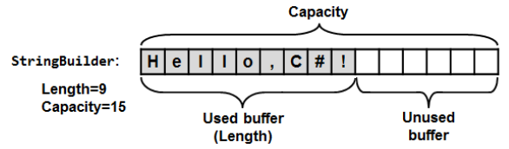
Sting builder

Slide 45
StringBuilder – More Important Methods
StringBuilder(int capacity) – constructor with an initial capacity parameter. It may be used to set the buffer size in advance if we have estimates of the number of iterations and concatenations, which will be performed. This way we can save unnecessary dynamic memory allocations.
Capacity – returns the buffer size (total number of used and unused positions in the buffer).
Length – returns length of string saved in the variable (number of used positions in the buffer)
Indexer [int index] – return the character stored in given position.
Append(…) – appends string, number or other value after the last character in the buffer.
Clear(…) – removes all characters from the buffer (deletes it).
Remove(int startIndex, int length) – removes (deletes) string from the buffer with a given start position and length.
Insert(int offset, string str) – inserts a string in a given start position (offset).
Replace(string oldValue, string newValue) – replaces all occurrences of a given substring with nother substring.
ToString() – returns the StringBuilder object content as a string object.

Slide 46
Extract all capital letters
Example…

Slide 47
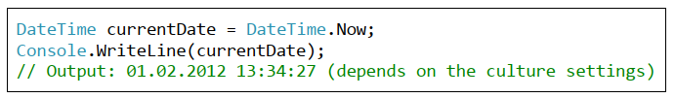
String Formatting The ToString(…) Method
One of the interesting concepts in .NET is that practically every object of a class and primitive variables can be presented as text. This is done by the method ToString(…), which is present in all .NET objects. It is implicit in the definition of the object class – the base class that all .NET data types inherit directly or indirectly. Thus the definition of the method appears in each class and we can use it to bring the content of each object in some text form.
The method ToString(…) is called automatically when we print objects from different classes to the console. For example, when printing dates the submitted date is converted to text by calling the ToString(…):

Slide 48
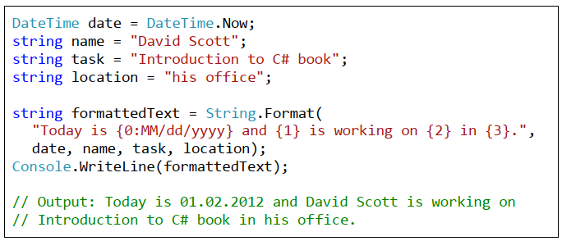
Using of String.Format(…)

Slide 49
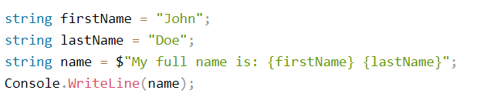
String Interpolation
More info:
https://dzone.com/articles/c-string-format-examples#:~:text=String%20Formatting&text=In%20C%23%2C%20the%20string%20Format,string%20representation%20of%20specified%20objects.

Slide 50
Exercises
Write a program that reads a string, reverse it and prints it to the console. For example: "introduction" => "noitcudortni".
Write a program that checks whether the parentheses are placed correctly in an arithmetic expression.
Example of expression with correctly placed brackets: ((a+b)/5-d).
Example of an incorrect expression: )(a+b))
Write a program that detects how many times a substring is contained in the text.
For example, let’s look for the substring "in" in the text:
We are living in a yellow submarine. We don't have anything else. Inside the submarine is very tight. So we are drinking all the day. We will move out of it in 5 days.
The result is 9 occurrences.

Slide 51
Exercises
4. Write a program that extracts from a text all sentences that contain a particular word. We accept that the sentences are separated from each other by the character "." and the words are separated from one another by a character which is not a letter.
Sample text:
We are living in a yellow submarine. We don't have anything else. Inside the submarine is very tight. So we are drinking all the day. We will move out of it in 5 days.
Sample result:
We are living in a yellow submarine.
We will move out of it in 5 days.

Slide 52
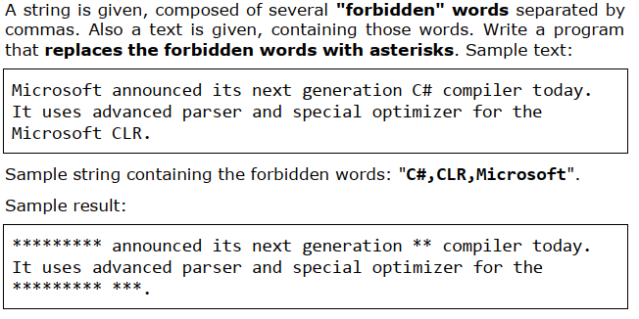
Exercises
5.

Slide 53
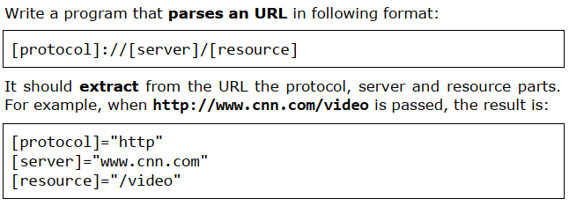
Exercises
6.

Slide 54
Exercises
7. Write a program that reads a string from the console and replaces every sequence of identical letters in it with a single letter (the repeating letter). Example: "aaaaabbbbbcdddeeeedssaa" => "abcdedsa".
8. Write a program that reads a list of words separated by commas from the console and prints them in alphabetical order (after sorting).
9. Write a program that reads a string from the console and prints in alphabetical order all letters from the input string and how many times each one of them occurs in the string. Hint: Use an array of integers int[65536], which will keep how many times each letter occurs.

Slide 55
Homework 1
Write a program that extracts all e-mail addresses from a text. These are all substrings that are limited on both sides by text end or separator between words and match the shape <sender>@<host>…<domain>.
Sample text:
Please contact us by phone (+001 222 222 222) or by email at example@gmail.com or at test.user@yahoo.co.uk. This is not email: test@test. This also: @gmail.com. Neither this: a@a.b.
Output:
example@gmail.com
test.user@yahoo.co.uk

Slide 56
Hint 1
Use RegEx.Match(…) with an appropriate regular expression.
If you want to solve the task without regular expressions, you will need to process the text letter by letter from start to finish and process the next character, depending on the current mode, which can be one of OutsideOfEmail, ProcessingSender or ProcessingHostOrDomain. If a separator or the end of the text is reached and host or domain is processed (mode ProcessingHostOrDomain), then you have found an email, otherwise potentially a new e-mail is starting and mode must be changed to ProcessingSender. If @ character is reached in ProcessingSender mode, ProcessingSender is switched on. When meeting letters or dot in ProcessingSender or ProcessingHostOrDomain mode, they ate accumulated in a buffer. You can look at all possible groups of characters encountered respectively in each of the three modes and process them appropriately. We come to something like a final automaton (state machine), which detects e-mail addresses. All found email addresses must be checked whether they have nonempty recipient, host, and domain with a length between 2 and 4 letters, as well as not beginning or ending with a dot.
Another easier approach to this problem is to split the text by all characters that are not letters and dots and to verify that the extracted "words" are valid e-mail addresses. Check can be done through an attempt to split them to nonempty parts: <sender>, <host>, <domain>, meeting the listed conditions.

Slide 57
Homework 2
Write a program that extracts all the text without any tags and attribute values from an HTML document.
Sample text:
<html>
<head><title>News</title></head>
<body><p><a href="http://vum.com">VUM</a>aims to provide free real-world practical
training for young people who want to turn into
skillful software engineers.</p></body>
</html>
Output:
News
VUM aims to provide best real-world
practical training for young people who want to turn into skillful software engineers.

Slide 58
Hint 2
Scan the text letter by letter and at all times keep in a variable whether currently there is an opening tag which has not been closed or not. If you have "<", enter in "opening tag" mode. If you have ">", exit the "opening tag" mode. If you have a letter, add it to the result only if the program is not in "opening tag". After closing a tag you can add a space in order not to "stick" the text before and after the tag.

Slide 59
Questions …

